Slide 1
Module 9: Spring Security Basics
A BPI Training Program
‹#›

Slide 2
Objectives
Day 1 — Introduction & Core Concepts
Notes:
‹#›

Slide 3
Objectives
Learning Objectives:
Explain the importance of application security in modern web applications.
Distinguish between authentication and authorization.
Identify common web security threats (session hijacking, brute-force attacks, etc).
Describe the core components of Spring Security architecture
Demonstrate the default behavior of Spring Security in a new Spring Boot application.
Discuss authentication
Notes:
‹#›

Slide 4
Spring Security Basics
Why Security Matters?
Security is a critical cross-cutting concern in all applications
Protects data, users, and business logic
Prevents common vulnerabilities:
Unauthorized access
Data leaks
Session hijacking
Brute force attacks
Notes:
‹#›

Slide 5
Spring Security Basics
What is Spring Security?
A framework that provides authentication and authorization for Spring applications
Manages user identity, access control, and session security
Helps protect against common web attacks like CSRF, session fixation, and clickjacking
Protects endpoints automatically and works seamlessly with Spring Boot out-of-the-box
Notes:
‹#›

Slide 6
Spring Security Basics
Core Security Features
Authentication
Authorization
Password Encryption
Session Management
CSRF protection
Notes:
‹#›

Slide 7
Spring Security Basics
Authentication vs Authorization
Authentication
Verifies who you are
Example: login with username & password
Can be in-memory, database, or external system
Authorization
Determines what you can do / what can you access
Example: only ADMIN can delete users; normal USER can only view users
Controlled by roles, permissions, or authorities
Flow
Authentication happens first
Authorization happens after authentication
Notes:
‹#›

Slide 8
Spring Security Basics
Components of Spring Security
The following are the basic components that form the spring security architecture.
Filters
Authentication Manager
Authentication Provider
UserDetailsService
Password Encoder
Notes:
‹#›

Slide 9
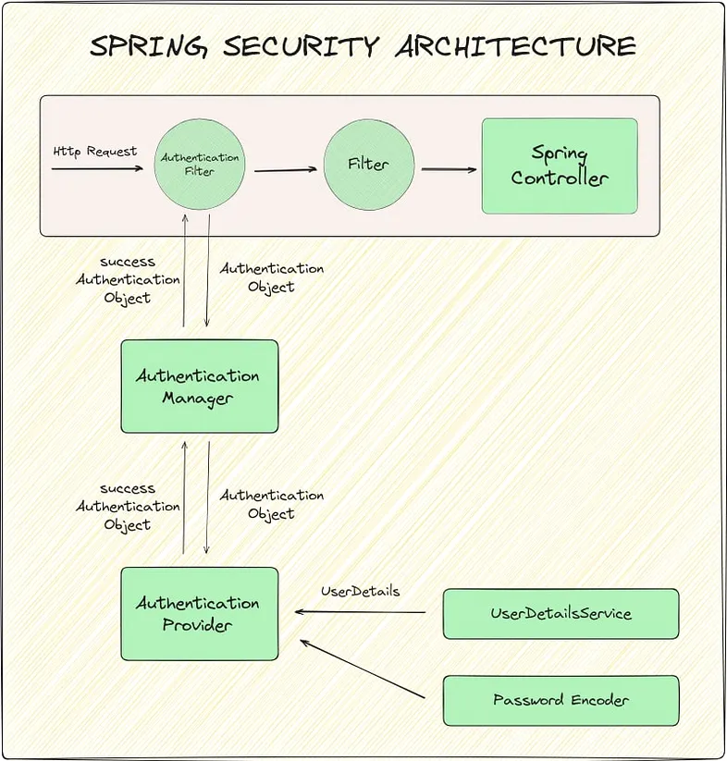
Spring Security Basics
Components of Spring Security
Notes:
‹#›

Slide 10
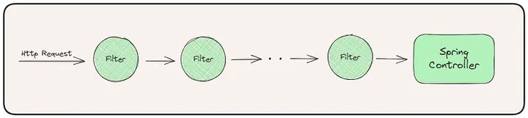
Spring Security Basics
Filter (Security Filter Chain)
Purpose:
Intercepts all incoming HTTP requests.
Applies security rules (authentication, authorization, CSRF checks).
Responsible for extracting user authentication details and tokens. These user details are packaged as authentication objects and passed to Authentication Manager.
Example:
Login requests intercepted by UsernamePasswordAuthenticationFilter.
Notes:
‹#›

Slide 11
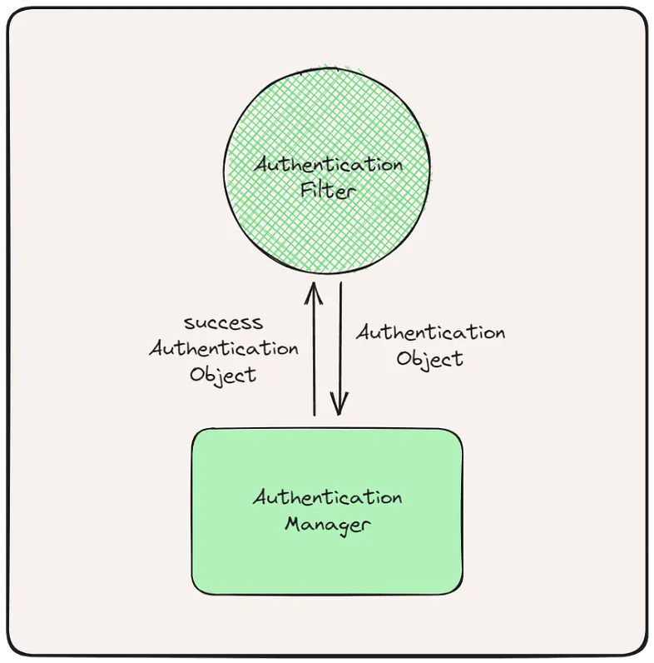
Spring Security Basics
Authentication Manager
Purpose:
Coordinates authentication process.
Delegates credential verification to one or more AuthenticationProviders.
Example:
Receives login request and passes username/password to providers.
Can combine multiple strategies (in-memory, DB, LDAP).
Notes:
‹#›

Slide 12
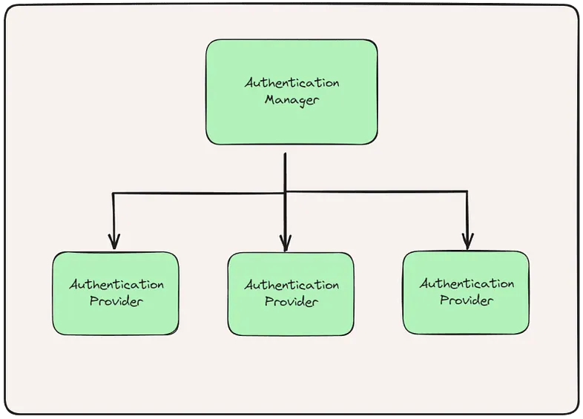
Spring Security Basics
Authentication Provider
Purpose:
Performs actual verification of credentials.
Throws exception if authentication fails.
Example:
DaoAuthenticationProvider checks username/password against UserDetailsService.
Can implement custom logic for third-party systems.
Notes:
‹#›

Slide 13
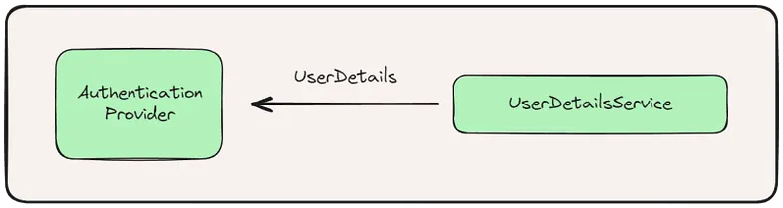
Spring Security Basics
UserDetailsService
Purpose:
Loads user information (username, password, roles/authorities).
Supplies data to AuthenticationProvider.
Example:
@Override
public UserDetails loadUserByUsername(String username) {
return userRepository.findByUsername(username)
.map(user -> new User(user.getUsername(), user.getPassword(),user.getRoles()))
.orElseThrow(() -> new UsernameNotFoundException("User not found"));
}
Notes:
‹#›

Slide 14
Spring Security Basics
Password Encoder
Purpose:
Encodes passwords securely (hashing + salt).
Ensures plain passwords are never stored in DB.
Works during login validation and password storage.
Example:
@Bean
public PasswordEncoder passwordEncoder() {
return new BCryptPasswordEncoder();
}
Notes:
‹#›

Slide 15
Spring Security Basics
Spring Security Flow
Client sends request
SecurityFilterChain intercepts
AuthenticationManager validates credentials
AuthenticationProvider checks password
UserDetailsService loads user info
SecurityContext holds authentication
Request proceeds to Controller
Notes:
‹#›

Slide 16
Spring Security Basics
Spring Security Setup in Spring Boot
Adding Spring Security
In your pom.xml, add the Spring Boot Security starter:
<!-- Spring Security -->
<dependency>
<groupId>org.springframework.boot</groupId>
<artifactId>spring-boot-starter-security</artifactId>
</dependency>
Notes:
‹#›

Slide 17
Spring Security Basics
Default Behavior (After adding spring security dependency)
1. All Endpoints Secured
Every HTTP endpoint in your application is secured by default.
Any request requires authentication (login) before it can be accessed.
2. Auto-generated Login Page
Spring Boot provides a default login page automatically.
No need to create any HTML or form for login initially.
Example URL: accessing http://localhost:8080/hello redirects you to /login
3. Auto-generated User
Spring Boot generates a random password for a default user user.
You can find it in the console log on startup
Notes:
‹#›

Slide 18
Spring Security Basics
Exercise #1: Add Spring Security to Spring Boot
Create a Spring Boot project
Add Spring Security dependency
Create a simple controller
Endpoint: /dashboard
Return a simple string message.
Access the endpoint in browser
Observe and proceed with the testing based on default behavior
Notes:
‹#›

Slide 19
Spring Security Basics
Customizing Authentication
Default Spring Security provides:
Generated user
Generated password
Default login page
However, real applications require:
Real users
Custom passwords
Role assignments
Secure password storage
Notes:
‹#›

Slide 20
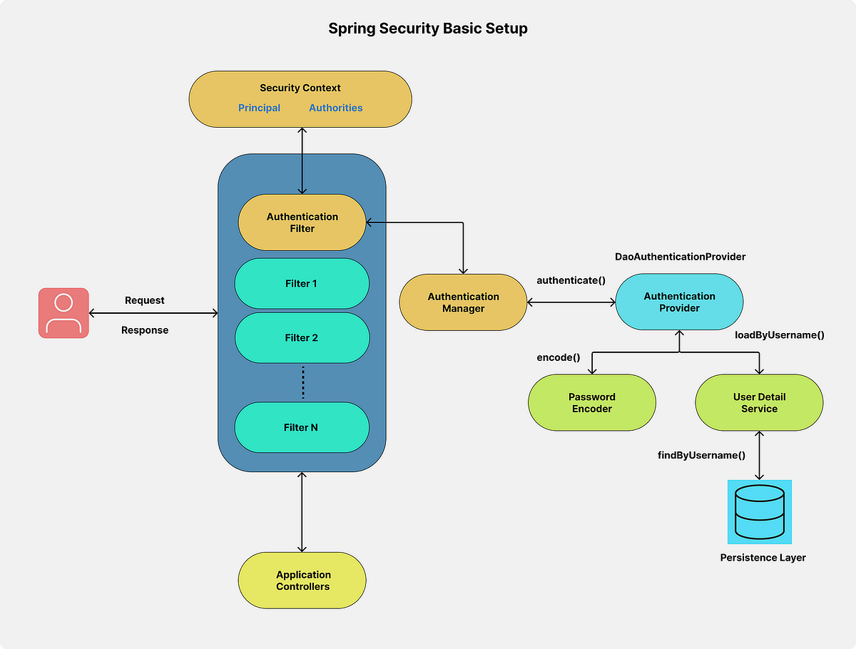
Spring Security Basics
Where Authentication Happens
Notes:
‹#›

Slide 21
Spring Security Basics
Where Authentication Happens
Spring Security authenticates users using several components:
SecurityFilterChain
↓
AuthenticationManager
↓
AuthenticationProvider
↓
UserDetailsService
Notes:
‹#›

Slide 22
Spring Security Basics
In-Memory Authentication
Users can be defined directly in configuration.
@Bean
public InMemoryUserDetailsManager userDetailsService() {
UserDetails user = User.withUsername("user")
.password("{noop}password")
.roles("USER")
.build();
UserDetails admin = User.withUsername("admin")
.password("{noop}password")
.roles("ADMIN")
.build();
return new InMemoryUserDetailsManager(user, admin);
}
Notes:
‹#›

Slide 23
Spring Security Basics
Exercise #2: Apply In-Memory Authentication
Objective
Replace Spring Boot’s default generated user.
Configure multiple users in memory.
Test authentication with usernames, passwords, and roles.
Notes:
‹#›

Slide 24
Spring Security Basics
Password Encoding
Never store plain-text passwords in your application.
Spring Security supports multiple password encoders.
Recommended for most applications: BCryptPasswordEncoder.
Example usage with in-memory users:
@Bean
public InMemoryUserDetailsManager userDetailsService() {
UserDetails user = User.withUsername("user")
.password(passwordEncoder().encode("password"))
.roles("USER")
.build();
return new InMemoryUserDetailsManager(user);
}
@Bean
public PasswordEncoder passwordEncoder() {
return new BCryptPasswordEncoder();
}
Notes:
‹#›

Slide 25
Spring Security Basics
What is Bcrypt?
BCrypt is a secure way to store passwords.
Instead of saving passwords in plain text, it converts them into a scrambled hash.
Even if someone steals your database, they cannot see the original passwords.
Why Use BCrypt?
Hashing – Turns your password into a fixed-length string that looks random:
password123 → $2a$10$E9eN1YfzjQ1uYlXw5p1lEe1hX0jlQ9m6QxyHfP3w0O4gYY9H6yB6K
2. Salting – Adds random data to every password hash:
Two users with the same password will have different hashes.
3. Slow hashing – Makes brute-force attacks much harder.
Notes:
‹#›

Slide 26
Spring Security Basics
Exercise #3: Apply Password Encoder (BCrypt)
Objective
Learn how to encode passwords for security.
Replace {noop} passwords with hashed passwords using BCryptPasswordEncoder.
Ensure authentication works with encoded passwords.
Notes:
‹#›

Slide 27
Spring Security Basics
Types of Authentication in Spring Security
Type | Description | When to Use
Form-Based Login | Login page with username/password | Web applications
HTTP Basic Auth | Username/password in HTTP header | APIs / testing
HTTP Digest Auth | Hash of credentials | Legacy systems
LDAP Authentication | Connects to LDAP server | Enterprise users
OAuth2 / OpenID Connect | External provider (Google, Facebook) | Social login, SSO
JWT Token Auth | Stateless API authentication | REST APIs & Microservices
Certificate / Mutual TLS | Client certificates | High-security systems
Notes:
‹#›

